Slide 1








ANTI-BULLYING WEEK 2025
Monday 10th to
Friday 14th November
Monday 10th November

Slide 2
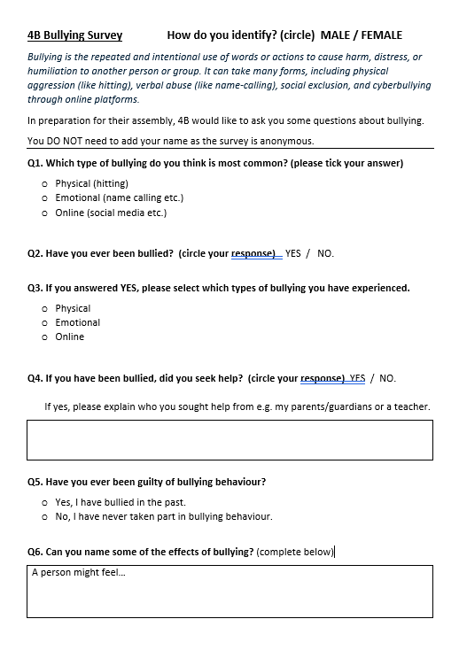
HOW DOES BULLYING AFFECT US AT HILL TOP?

Slide 3
74%
CONSIDER THAT THEY HAVE BEEN BULLIED
YOU TOLD US…
46%
SOUGHT HELP FROM SOMEONE
YOU TOLD US…
PHYSICAL (hitting)
Which is the most common?
ONLINE (social media)
EMOTIONAL (name calling)

Slide 4
74%
CONSIDER THAT THEY HAVE BEEN BULLIED
YOU TOLD US…
46%
SOUGHT HELP FROM SOMEONE
YOU TOLD US…
56%
ONLINE (social media)
YOU TOLD US…
35%
EMOTIONAL (name calling)
7%
PHYSICAL (hitting)

Slide 5

LONELY
YOU TOLD US HOW IT MAKES YOU FEEL…
WORTHLESS
STRESSED
SAD
ANGRY
UPSET
DEPRESSED

Slide 6





WE CAN MAKE A HUGE DIFFERENCE

Slide 7

WHAT IS POWER?

Slide 8
Control
Attacking
Hurting
Destroying
WHAT IS POWER?
(it can be negative)

Slide 9
Kindness
Caring
Inclusive
Brave
WHAT IS POWER?
(look at the positives)

Slide 10


HOW CAN YOU USE YOUR POWER FOR GOOD?

Slide 11
DURING THE WEEK, THINK ABOUT HOW YOU CAN HELP STOP BULLYING.

Slide 12
IF YOU SEE BULLYING…
DON’T LET A FRIEND STAY SAD
TELL A TRUSTED ADULT
REMIND THEM THAT YOU CARE

Slide 13
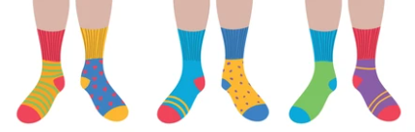
SHOW YOU CARE BY TAKING PART IN ODD SOCKS MONDAY

Slide 14
ANTI-BULLYING WEEK 2025
Monday 10th to
Friday 14th November
Monday 10th November

